Slide 1



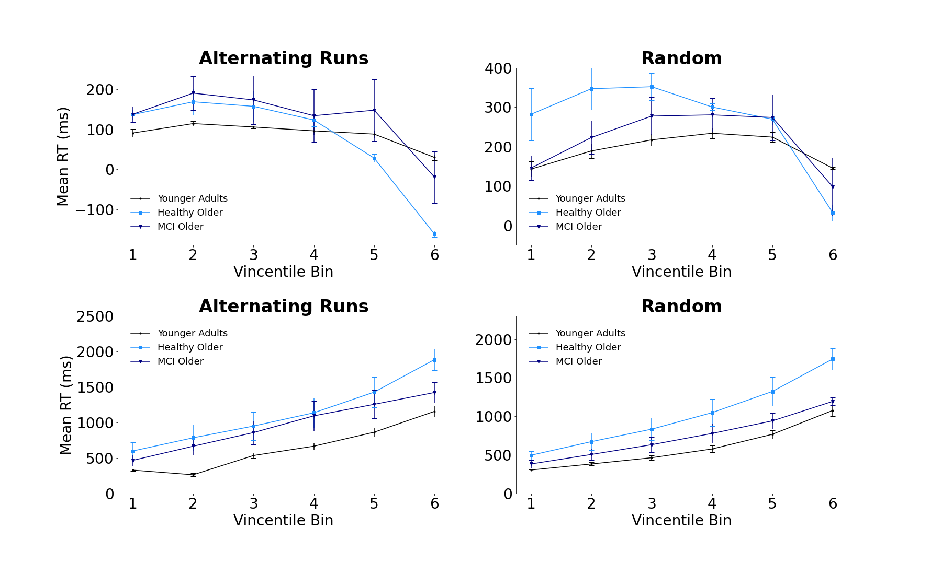
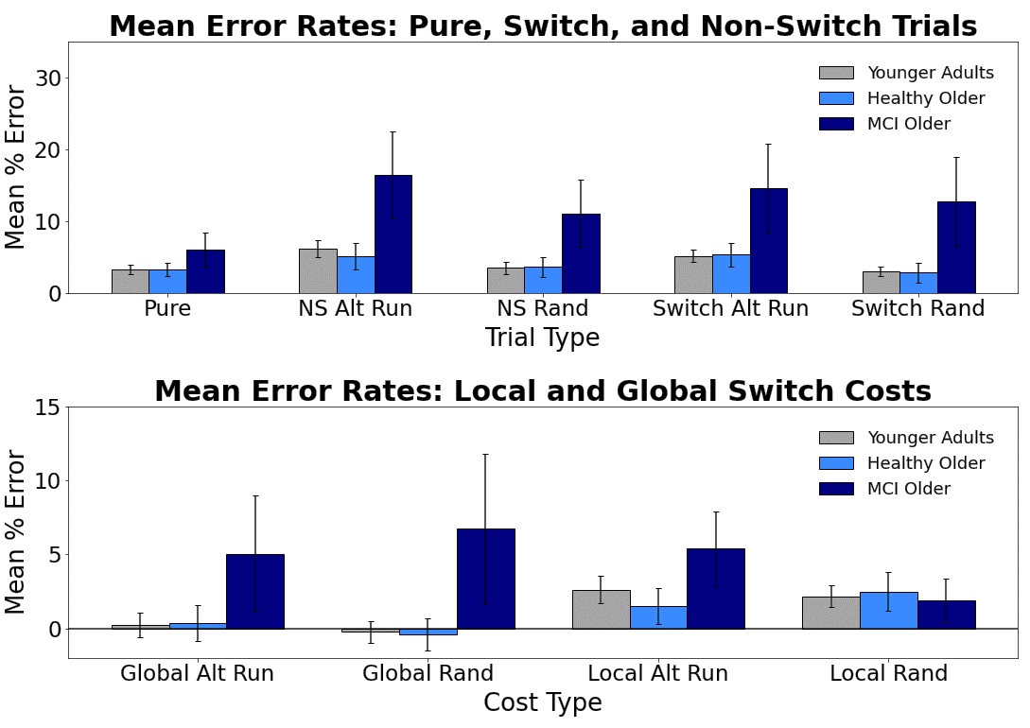
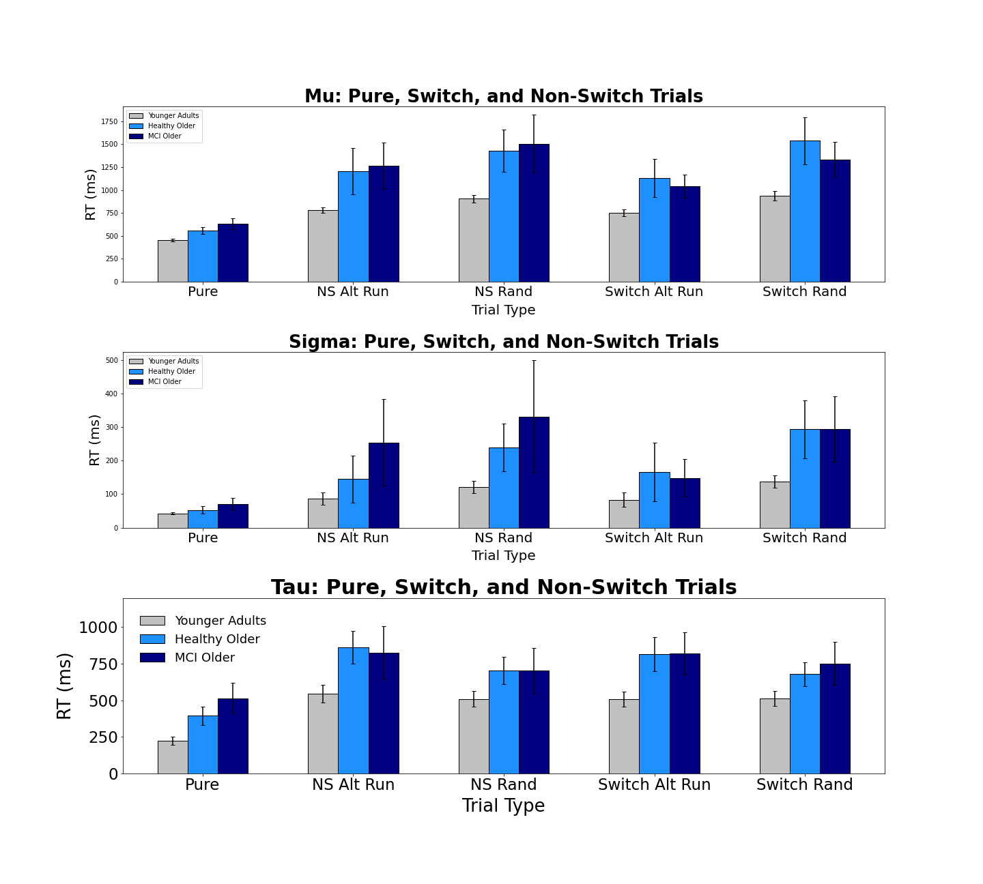
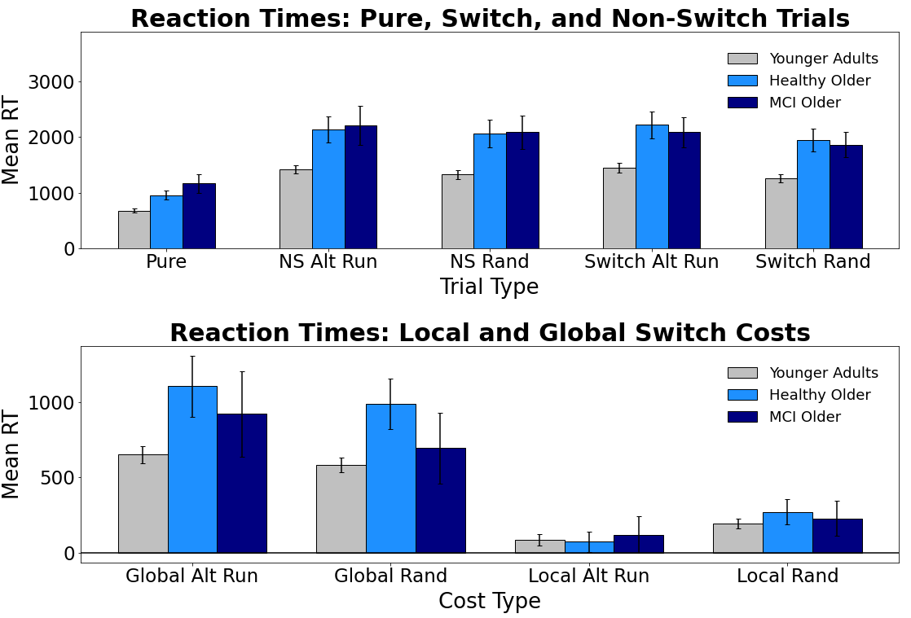
Evaluating Switch Costs using Alternating-Runs and Random Sequencing in the Consonant-Vowel/Odd-Even Task in Younger, Healthy Older, and Mildly Impaired Older Adults
Jacob M. Namias, Nicholas P. Maxwell, & Mark J. Huff
Introduction
General Method
Vincentile Plots
In the Consonant-Vowel/Odd-Even switch task (CVOE, Minear & Shah, 2008) participants view bivalent stimuli (e.g., A 08) and must quickly classify the letter (Consonant/Vowel) or the number (Odd/Even). Because participants complete both pure blocks (e.g., all trials are the CV task) and switch blocks (e.g., participants switch between both classification tasks), the CVOE paradigm allows for comparisons between global and local switch costs. Global costs (i.e., non-switch trials - pure trials) represent the cost of keeping multiple task-sets active in working memory. Alternatively, local costs (i.e., switch trials - non-switch trials) reflect task-set reconfiguration processes that occur due to switching.
Previous research has found that global costs for both RTs and error rates increase as a function of both age and Alzheimer's Disease (AD) diagnosis, while local costs show a decrease for RTs (Huff et al., 2015). However, previous work has used switch blocks in which switching occurs via a predictable, alternating runs sequence (e.g., CV, CV, OE, OE, CV, CV). In the present, we compare alternating runs switching with random switching. Unlike alternating runs, the random switch block had no discernable pattern for participants to detect. We expected that this task would be more difficult for participants, particularly for older adults and individuals with mid AD status. Thus, we expected that differences in switch costs previously found using alternating runs would be exaggerated when switching was non-predictive.
Pure Blocks
Switch Blocks
MoCA
Local Switch Costs
Note: Participants completed blocks. The first two blocks always contained pure trials (CV or OE). The final two sets of trials were always switch blocks (Alt Runs or Random)
Global Switch Costs
Results: Mean Errors
Ex-Gaussian Analyses
Bars = 95% CI
Participants
Bars = 95% CI
Group | n | M Age | % Female | M MoCA
Young Adults | 89
Healthy Older | 33 | 73.92 | 75% | 27.75
MCI Older | 26 | 75.88 | 41% | 24.00
Results: Mean RTs
Bars = 95% CI
Conclusions
Materials
Letters: A, D, E, H, I, J, I, P, S, U
Numbers: 1-99
Pair
A 15
D 04
E 23
H 36
Task
CV
CV
OE
OE
Correct Response
P
Q
Q
P
Correspondence can be addressed to jacob.namias@usm.edu.
More info available at: www.macapsych.com | https://osf.io/yrdsz/
Bars = 95% CI

